Slide 1
Diagrams and Figures
Big Data Summer Immersion at Yale
Shelby Golden, M.S.
June 27th, 2025

Slide 2
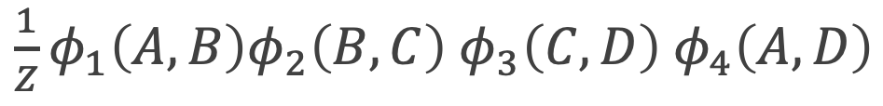
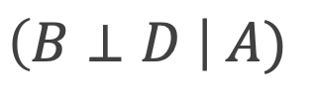
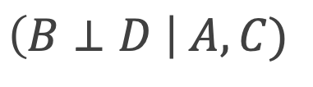
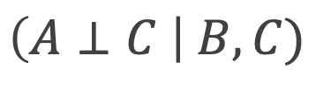
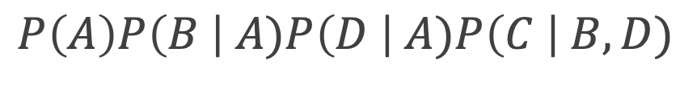
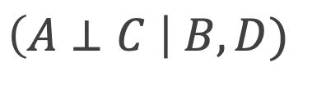
Bayesian networks
Markov networks
A
A
A
D
D
B
D
B
B
Graph Representation
C
C
C
Independencies
$$\left(B⊥D \right| A)$$
$$\left(A⊥C \right| B, C)$$
$$\left(A⊥C \right| B,D)$$
$$\left(B⊥D \right| A, C)$$
Factorization
$\frac{1}{Z}φ_{1}\left(A,B\right)φ_{2}\left(B,C\right)$ $φ_{3}\left(C,D\right)$ $φ_{4}\left(A,D\right)$
$$P\left(A\right)P\left(B \right| A)P\left(D \right| A)P\left(C \right| B,D)$$
Notes:
Based on Figure 1.1 from Probabilistic Graphical Models by Koller and Friedman

Slide 3
Collapsed Particle
Block Gibbs Sampling
Random Variable Assignment
Full Particles
Gibbs Sampling
Deterministic Calculation
From a Distribution
Particle Generation
Notes:
Abstraction of the introduction to Chapter 12 Particle-Based Approximate inference found in Probabilistic Graphical Models by Koller and Friedman.
Points on the graph are only illustrative of the variation in techniques.

